Slide 1
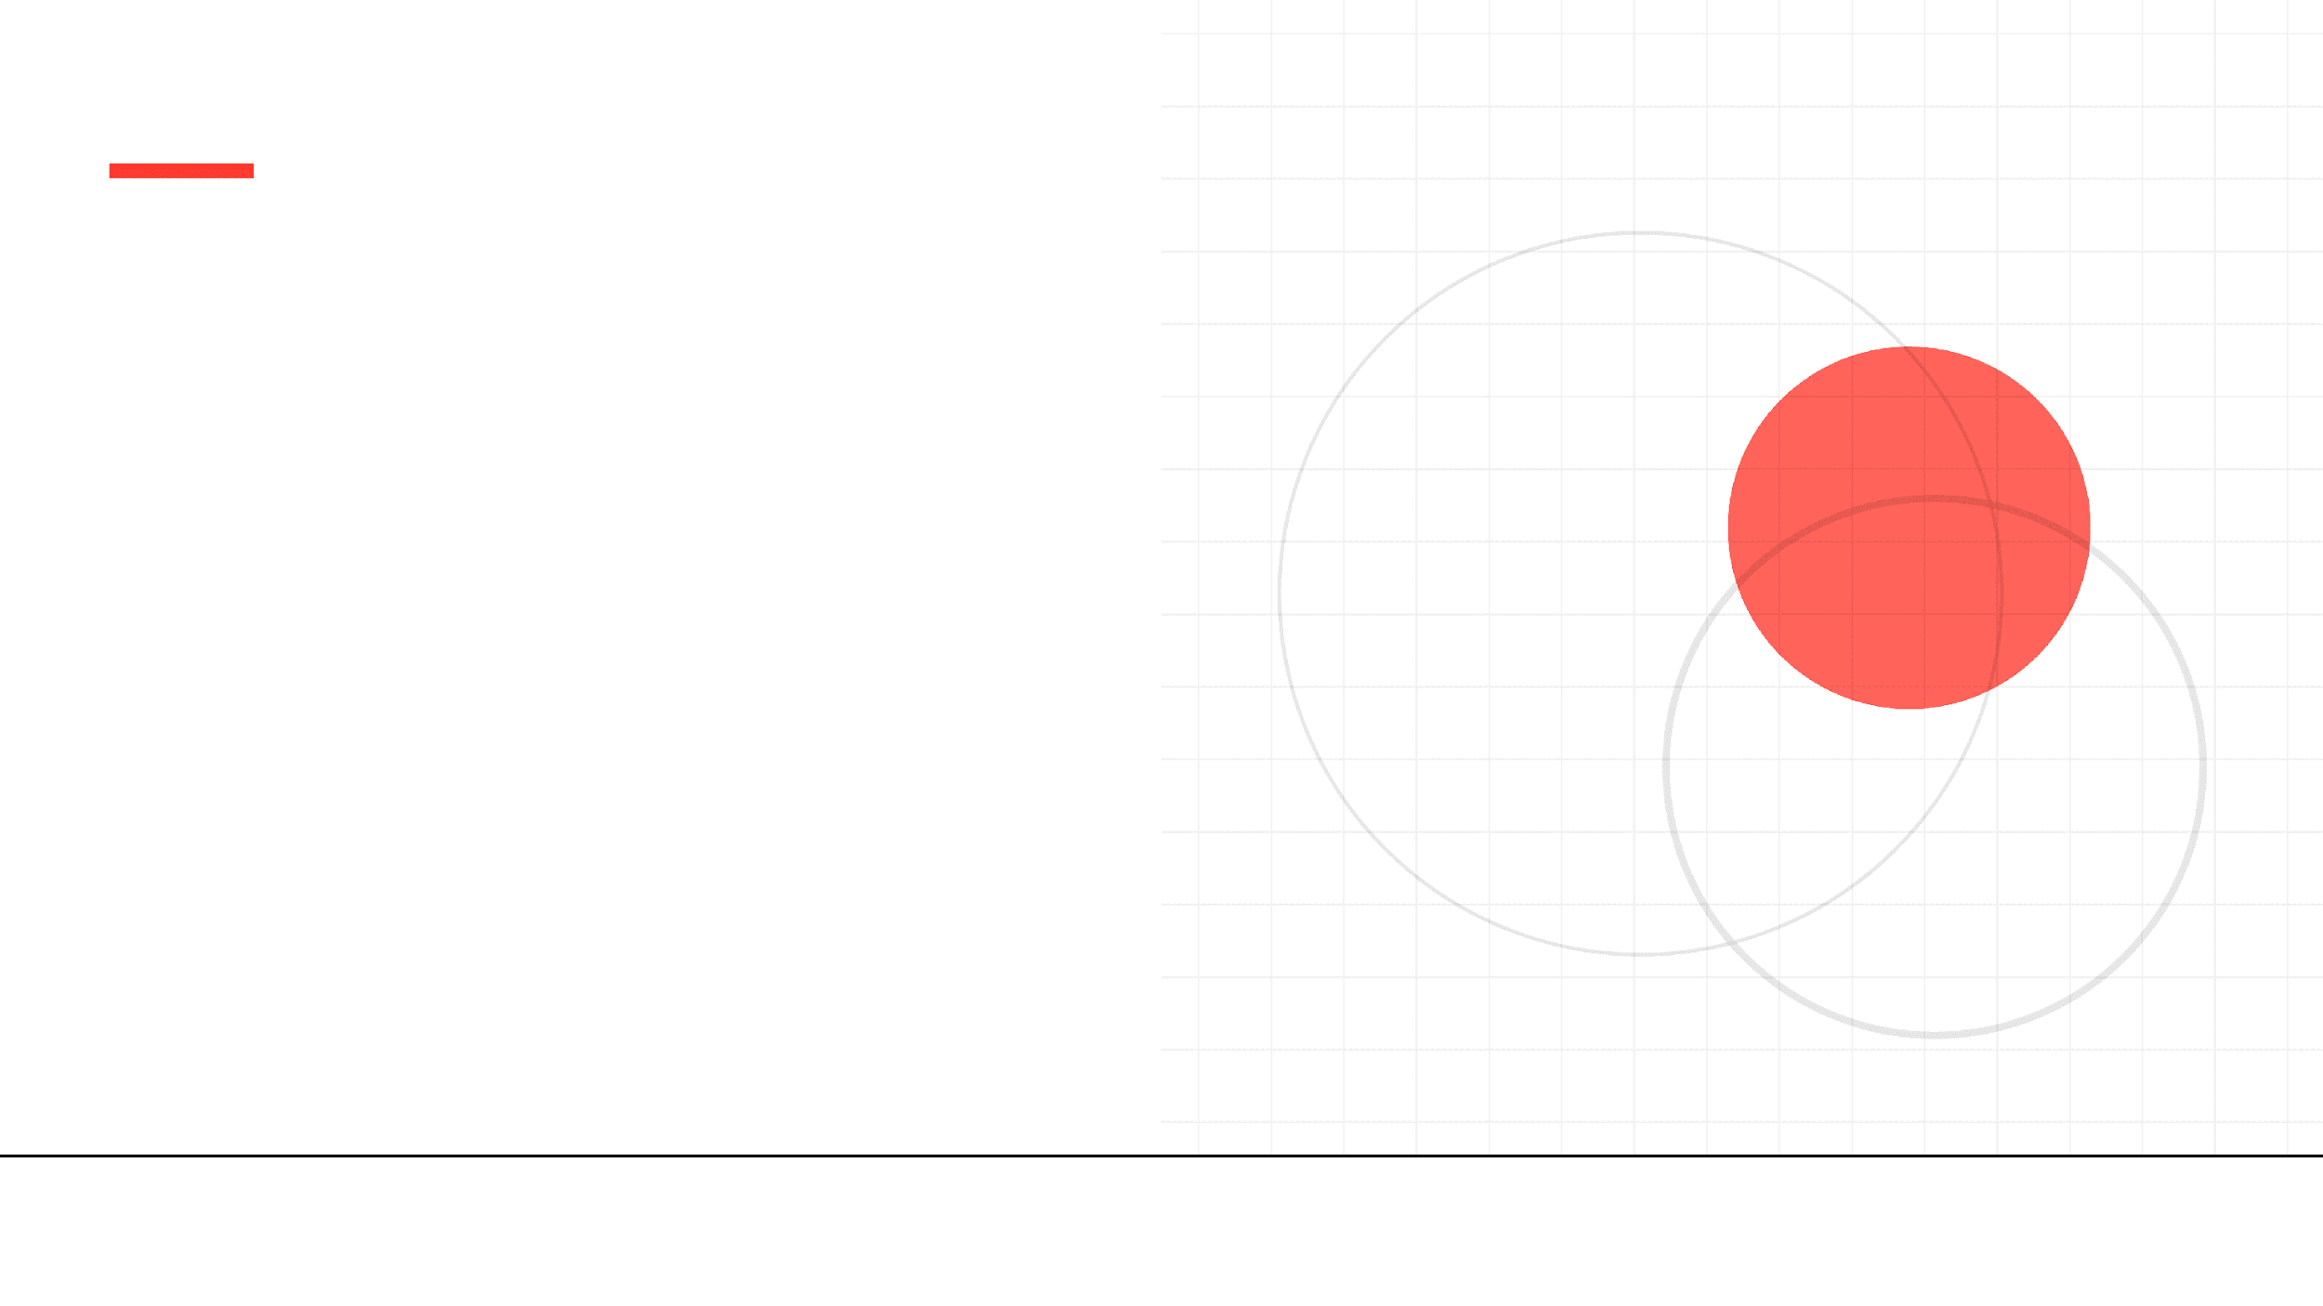
Arvi Health
Transforming Clinical Documentation with AI
Reducing administrative burden, restoring focus on patient care
Investment Ask
Product Launch
Contact
$2,000,000 Seed Round
1 March 2026
arvihealth.com

Slide 2




The Problem
Clinicians Are Drowning in Documentation
Australian GPs are spending nearly half their workday on administrative tasks instead of patient care, leading to unprecedented levels of burnout.
50%
#1
Time Poverty
Average GP sees 6.8 patients per day but spends hours after-hours completing notes.
Of GP time spent on documentation
Cause of physician burnout globally
Disconnected Systems
Manual data transfer between multiple platforms creates friction and errors.
31k+
177M
High Costs
GPs in Australia affected
Annual services requiring notes
Traditional human scribes cost practices $35k-$50k annually per FTE.

Slide 3

Global Momentum
Massive Capital Inflow into AI Scribes
Startup Daily
Mar 2025
Heidi Health (Australia) raises $16.6M Series A to free up clinicians
Technavio Report
Australian Competitor Validation
$28.6B
Fierce Healthcare
Feb 2024
Abridge clinches $150M to build out generative AI for documentation
Global Medical Transcription Market by 2028
Series C • US Market Leader
"AI scribe funding doubled to $800M in 2024. Investors see massive potential in ambient AI savings."
VentureBeat
July 2025
Freed announces 20,000+ clinicians actively using its AI scribe platform
Massive Market Adoption
The market is validated. Heidi Health's $16.6M raise proves Australian investors are betting big on this specific technology.

Slide 4


Market Opportunity
Bottom-Up Australian Market Sizing
TAM
Methodology
$63.8M
Calculated based on blended ARPU of $76/month (Base + Usage) across the AHPRA workforce.
Total Addressable Market (100% of 70k Clinicians)
The Specialist Upside
SAM
Includes 30,000+ specialists who generate higher revenue per consult and are underserved by current GP-focused tools.
$36.5M
Serviceable Market (Metro GPs + Specialists)
Usage Revenue Layer
Our $30 base price removes friction, while usage top-ups drive ARPU to ~$76 as adoption scales.
Year 3 Target
$16.9M
Obtainable Market (18,000 Users)
Validated Unit Economics

Slide 5








The Solution
Enterprise-Grade Clinical Intelligence
Ambient Scribe
Smart Structuring
Interoperability
Discharge Automation
Passive listening technology captures the consult naturally, distinguishing between multiple speakers without wake words.
Automatically converts dialogue into structured clinical notes (SOAP), letters, and summaries instantly.
Built on HL7/FHIR standards for seamless integration with Practice Management Systems and Hospital EMRs.
Generates immediate discharge summaries and operation notes, reducing bed block and admin delays.
Hospital Ready
Hospital Ready
1. Consult
2. Transcribe
3. Structure
4. Integrate (PMS/EMR)

Slide 6
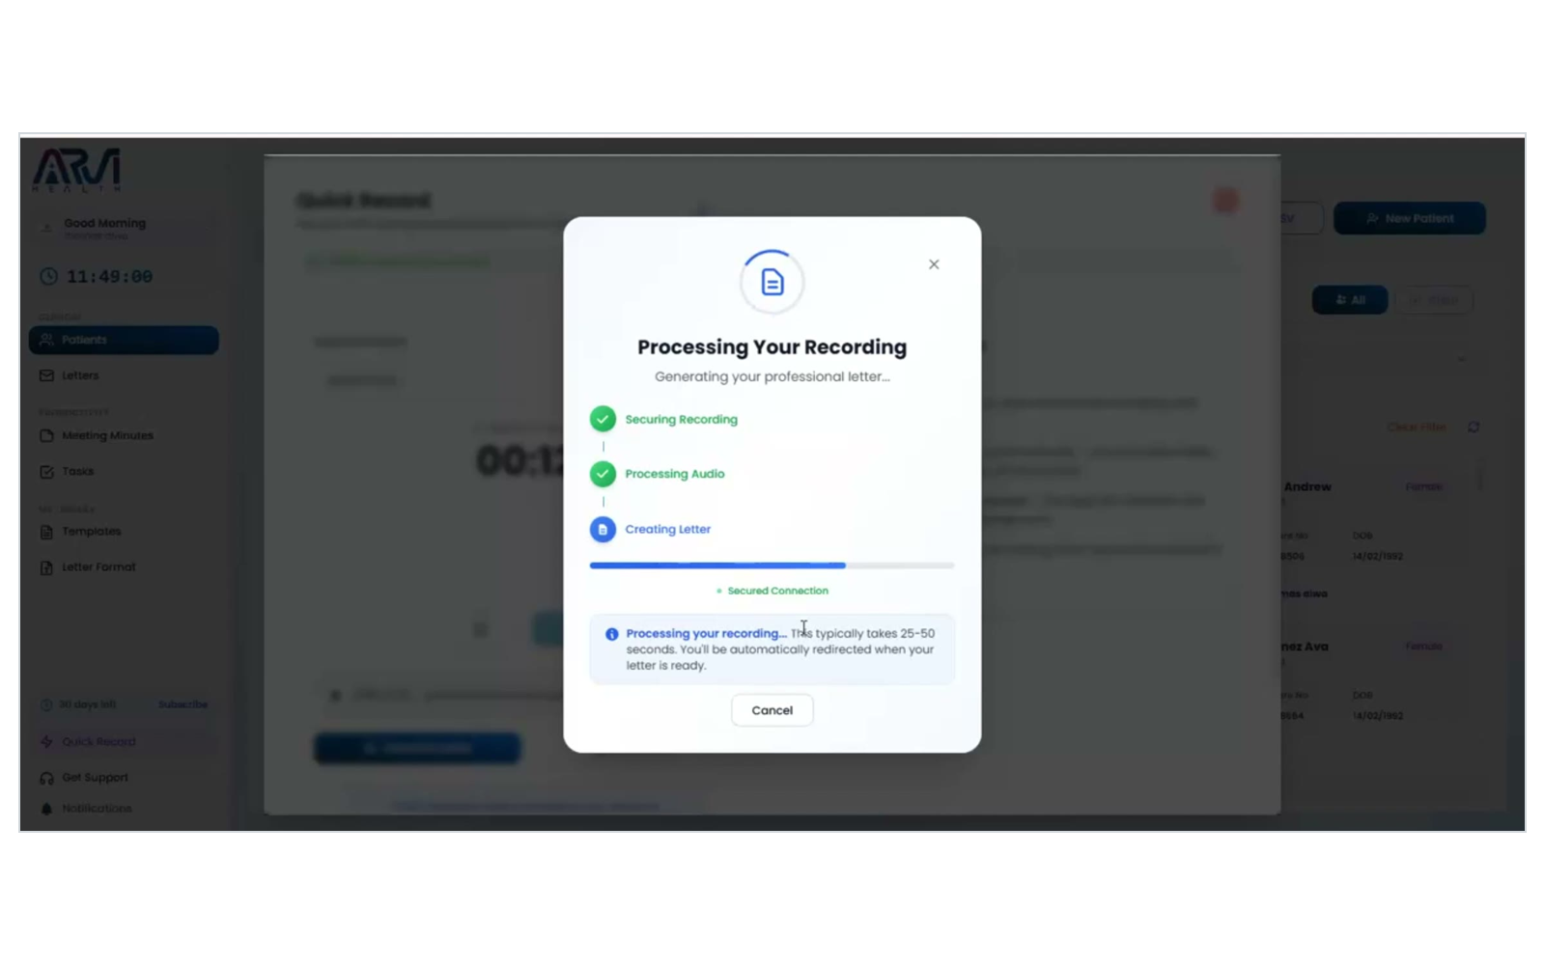
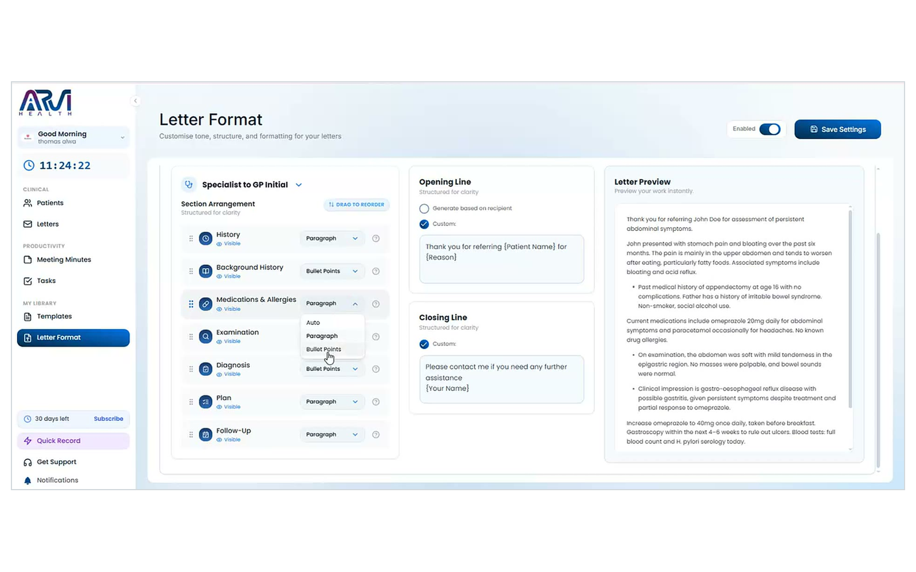
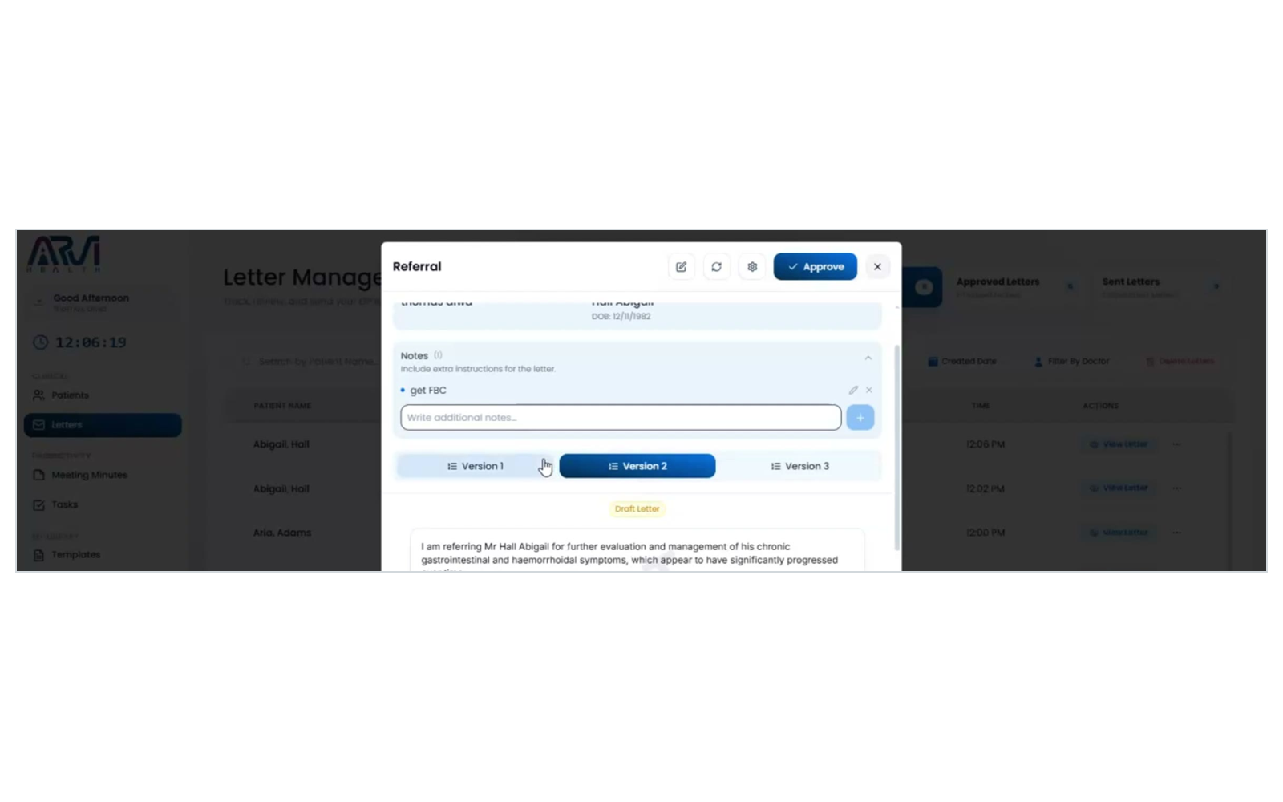
THE PRODUCT
One consult, every document
One recording becomes the note written for you, your letters your way, and the referral drafted on the spot.
Start your consult
Open the patient's appointment and tap record. Not booked in? Quick Create and start straight away.
Set up your letter templates
Do this once and your letters always come out looking the way you like.
Write your referral
From that same consult, Arvi drafts the referral. Read it over and change anything on one screen.
NOTES, LETTERS & PATIENT SUMMARIES · ALL FROM ONE RECORDING

Slide 7

Business Model
Disruptive Per-User Pricing
Low Barrier to Entry
Plan
Includes
Monthly Price
Effective / User
At ~$30/user, we are significantly cheaper than competitors ($100+), enabling rapid bottom-up adoption by individual doctors.
Pro
1 Clinician + Admin
$29.99
$29.99
Usage Upside
Team 3
3 Clinicians + Admin
$29.00
$87.00
Base plan covers standard usage. Heavy users buy "Token Top-ups", increasing ARPU without penalizing light users.
Team 5
5 Clinicians + Admin
$29.00
$144.99
Annual Lock-in
Enterprise
Unlimited + API
Custom Volume Pricing
17% discount for annual upfront payment improves cash flow and reduces churn.
Unit Economics (Projected)
$366
>3:1
Annual Contract Value
LTV:CAC Ratio

Slide 8





Competitive Landscape
Superior Quality & Accessible Pricing
BEST VALUE
Feature
Nuance DAX
Lyrebird Health
Arvi Health
Pricing Model
Expensive Contract
Fixed Subscription
Per User + Usage
Target Market
Hospitals / Enterprise
General Practice
GP & Specialist Clinics
Clinical Validation
Standard
Standard
Specialist-Led (Gastro)
Healthlink Integration
Limited
(In Progress)
Australian Compliance
Entry Barrier
High ($$$$)
Medium ($$)
Lowest (~$30/mo)
The Quality Advantage
Unlike generalist competitors, Arvi's transcription engine is being trained and validated daily in a specialist gastroenterology setting, ensuring superior handling of complex medical terminology.

Slide 9




Traction & Validation
Proven in Real Clinical Setting
Live Deployment: Sydney Gut Clinic
Currently running in production, validated daily by specialists in complex gastroenterology consultations. Owned by Co-founder Dr Suhirdan.
Production Ready
Development Milestones
Core AI transcription engine fully developed
12-Month Post-Launch Targets
Patient profile & records system complete
500
$3M
Automated referral letter generation live
Australian privacy compliance certified
Practices
ARR
1,800
>50
Active Users
NPS Score
Commercial Launch Date
1 March 2026

Slide 10





Go-to-Market Strategy
Focused Growth to Enterprise Scale
Phase 1
Phase 2
Phase 3
Launch & Adoption
Market Expansion
Enterprise & Hospital
Months 1-6
Months 7-12
Year 2+
•
Launch with Sydney Gut Clinic as reference
•
Rollout to Brisbane, Perth, Adelaide
•
Hospital Network Pilots
(Discharge Summaries)
•
Focus on Metro Sydney & Melbourne GPs
•
Launch Healthlink integration
•
Direct sales to private practices
•
Partnerships with Practice Management Software
•
Registrar support tools to reduce burnout
•
30-day free trial acquisition
•
Deep EMR integrations (InfoMedix/Cerner)
•
Specialist vertical expansion (Cardio, Ortho)
•
Enterprise-wide licensing
100 Practices
500 Practices
$10M+ ARR
Target Milestone
Target Milestone
Target Milestone
Key Channels
Direct Outreach
Medical Partnerships
Hospital Networks
Digital Marketing

Slide 11

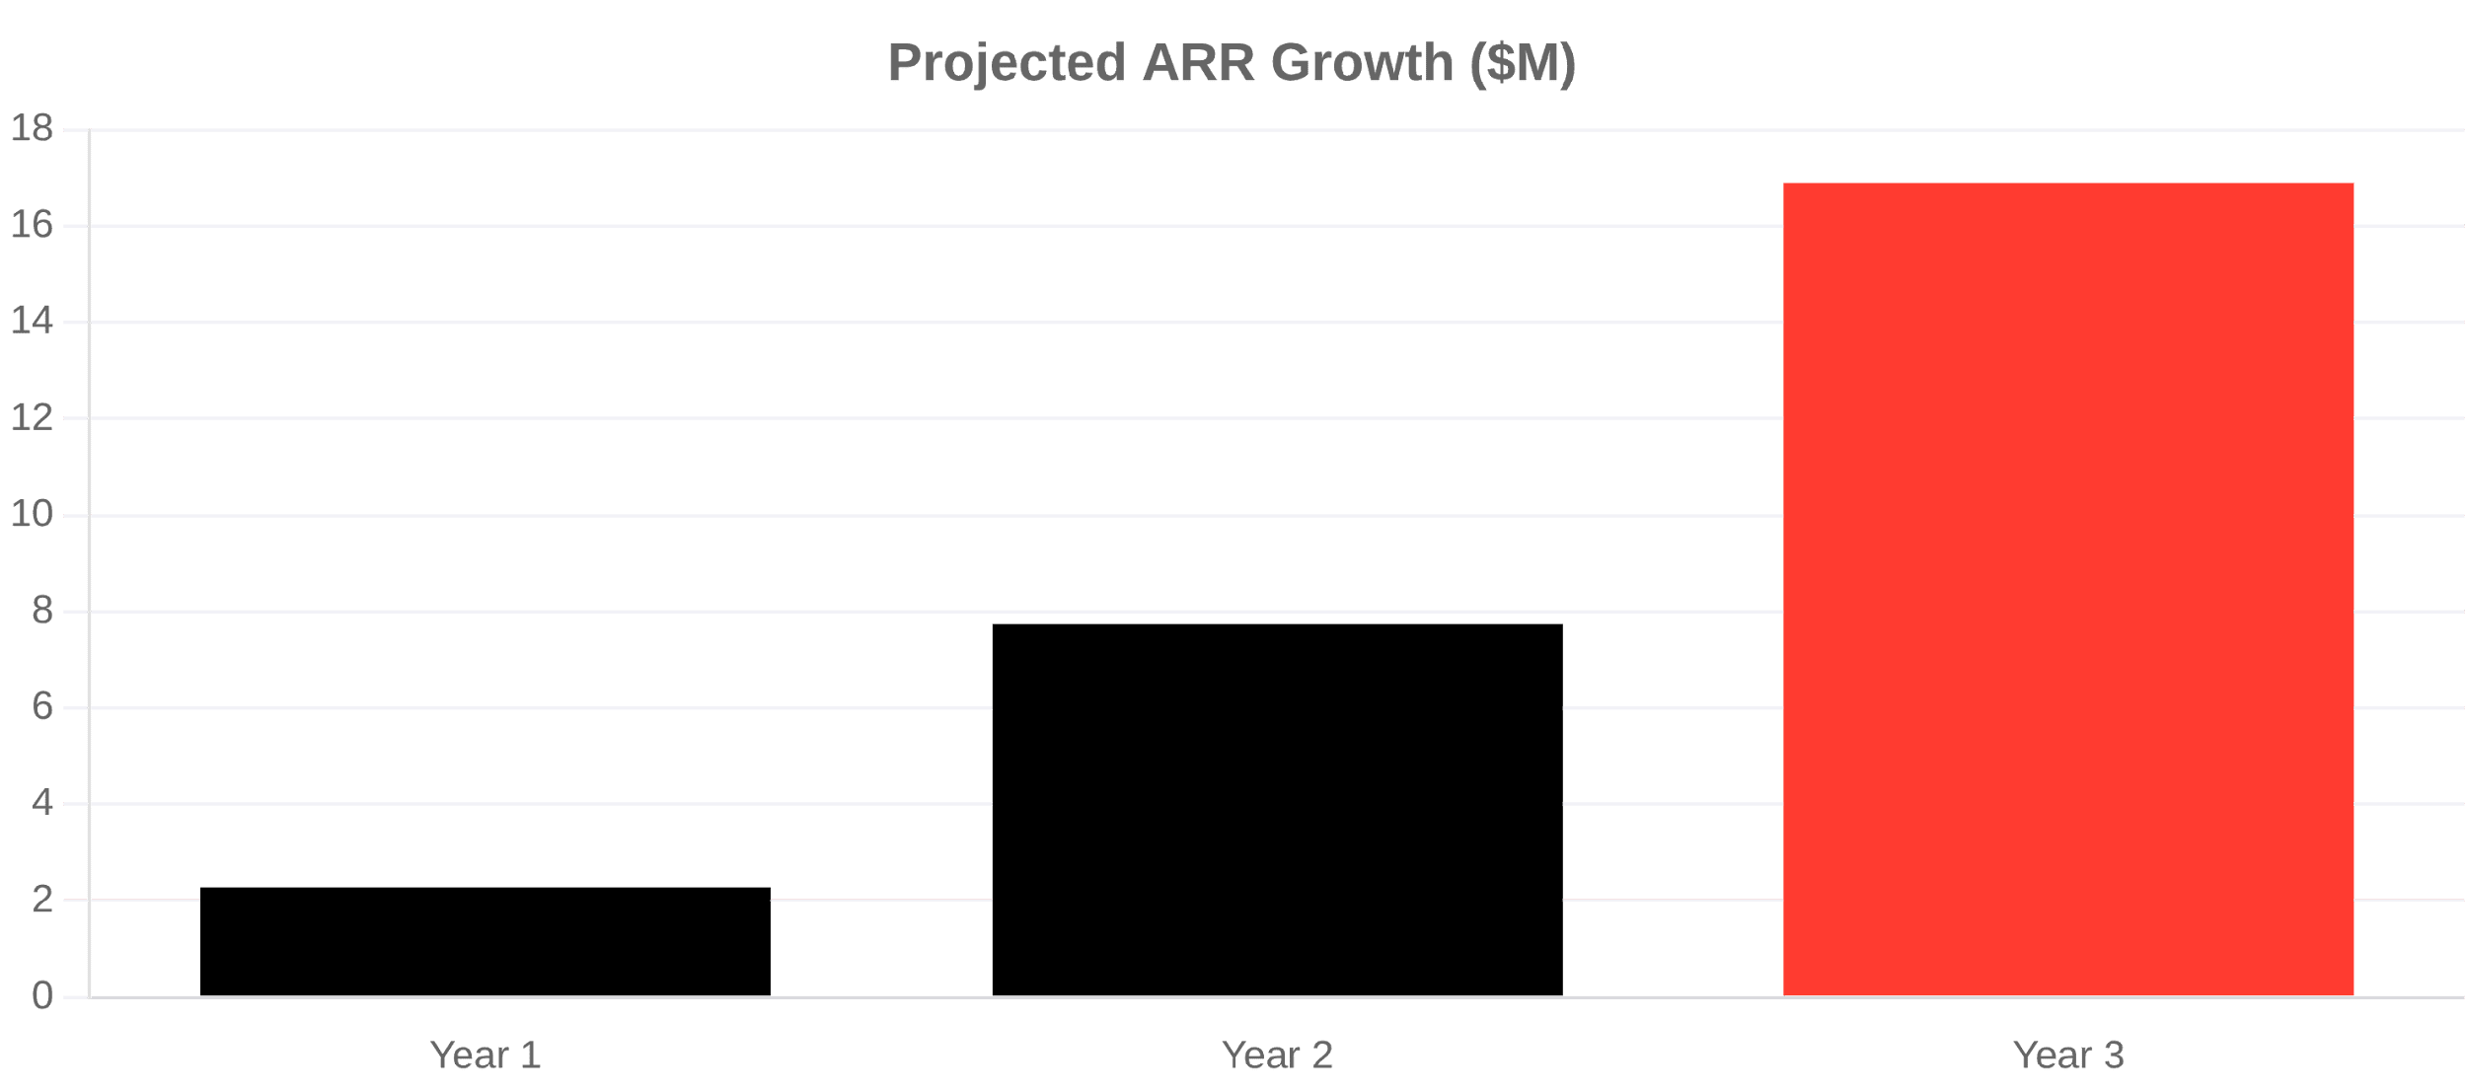
Financial Projections
Path to $10M+ ARR
Blended ARPU
~$76
$30 Base + $46 Usage
LTV : CAC Target
5.1:1
Highly Efficient Growth
Market Penetration
46%
Of Initial SAM by Year 3
Metric
Year 1
Year 2
Year 3
Series A Goal
Active Users
2,500
8,000
18,000
Q1 Year 2
Blended ARPU
$76
$76
$76
@ $5M+ ARR
YoY Growth
-
240%
116%
Total ARR
$2.3M
$7.8M
$16.9M

Slide 12



The Team
Clinical Expertise Meets Tech Excellence
Ari Vivekanandarajah
Dr Suhirdan Vivekanandarajah
Co-Founder

Successful
SaaS Exit
Co-Founder

20+ years experience in B2B marketing & growth and Agency owner

Practising
Gastroenterologist
& Clinic Owner

Expertise in scaling technology companies

Provides deep clinical workflow validation

Leads strategy, sales, and operations

Direct access to medical specialist networks

Specialist in healthcare and health services marketing

Leads product vision and medical partnerships
A 50-50 partnership combining proven SaaS scaling with deep medical authority.

Slide 13






Investment Highlights
Why Invest Now?
$28.6B Global Market
Exceptional Team
Clinical Validation
Massive tailwinds with recent $150M+ raises in the sector (Abridge, Tandem).
Rare combination of a successful SaaS Exit Founder and a practising Medical Specialist.
Product is live, tested, and validated daily in a complex specialist clinic environment.
Disruptive Pricing
Strategic Hospital Value
High-Growth Trajectory
~$30/user/month entry point significantly undercuts competitors, driving rapid adoption.
Architecture ready for InfoMedix integration and automated discharge summaries to reduce bed block.
Projecting $16.9M ARR by Year 3 with rapid acceleration to $2.3M ARR in Year 1.

Slide 14





The Ask
Join Us in Transforming Healthcare
$2.0M
12-Month Deliverables
Market Leadership Secure 2,500+ active users across Australia
Seed Round Investment
Revenue Growth Achieve $3.6M ARR run-rate
Sales & Marketing
50%
Product Scale Full Healthlink integration & Enterprise readiness
Product Development
25%
Operations & Support
20%
Series A Ready Positioned for Series A at $5M+ ARR (Year 2)
Working Capital
5%
Ari Vivekanandarajah, Co-Founder
WEB arvihealth.com
EMAIL ari@arvihealth.com

Slide 15

“
We believe clinicians should spend their time caring for patients, not fighting with paperwork.
Arvi Health uses AI to eliminate documentation burden, reduce burnout, and restore the joy of practising medicine.
Web arvihealth.com
Email ari@arvihealth.com

